Slide 1
Autonomous Ground Vehicle
Fall 2014
Team Members:
Spencer Lee - slee163@ucr.edu
Ryan Sabik - rsabi001@ucr.edu
Billy Xiao - bxiao001@ucr.edu

Slide 2
Slide 2: Concept and application of the design
What are we designing?
We are designing an Unmanned-Autonomous Ground Vehicle
Some of the technical principles we are covering are:
As a team, we developed skills in project management and learned how to further understand datasheets
What are the intended applications?
We intend this to further increase the possibilities of automobiles operating on its own without a driver and be able to relay current information back to the user.
This is related to electrical engineering because we deal with signal processing, manipulation of frequency to drive motors, and use electrical components that we learned over the years.
Notes:
What are you designing, technical principles, why this is a meaningful project, what are the intended applications, how is it related to subjects in electrical engineering.

Slide 3
Slide 3: Technical design objectives
Design Objectives:
Wifi communications:
To relay manual commands within 250ms:
Current Status such as speed, proximity around device, etc.
UltraSonic Sensors:
Used for proximity sensor, self-navigating and also self mapping.
Good up to 13 ft.
Raspberry Pi:
Processor chosen because of its ability to do image processing
Power consumption: about 5-7 watts
Small Form factor and allows a large amount of USB peripherals:
Notes:
Be specific and should be numerical and measurable, e.g., response time,
speed, frequency or transmission range, SNR, accuracy, false alarm rate, power consumption, capacity, etc.

Slide 4
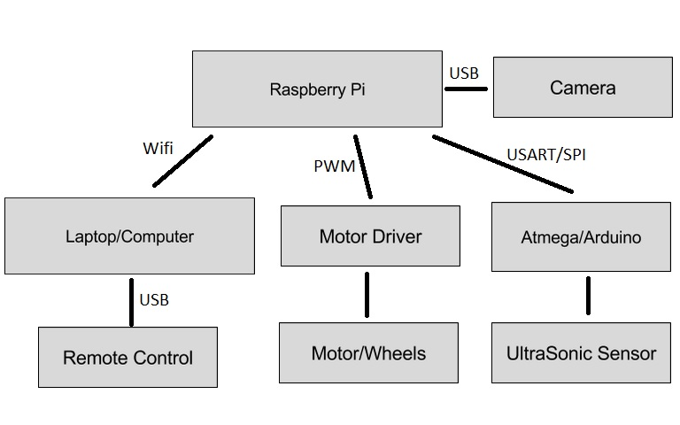
Slide 4: High level design
Notes:
show block diagram of the system.

Slide 5
Slide 5: Technical challenges
Wifi Speed Challenges:
Having difficulties sending commands to device in a reasonable amount of time.
Device initially took really long time to react with TCP protocol.
Waited until buffer was ready
Then we switched using UDP protocol, took about 2 seconds.
Problem was sending too frequently: too much empty data
Ultrasonic:
Had a hard time figuring out interrupt registers
Ran fine independently, but had problems running with Raspberry Pi
USART/SPI problem relaying input, interrupt register problems.

Slide 6
Slide 6: Major tasks and Responsibilities
Raspberry Pi:
Spencer Lee
Networking
Spencer Lee
Ryan Sabik
UltraSonic Sensor:
As well as mapping algorithm
Ryan Sabik
Billy Xiao
Image Processing:
Ryan Sabik
Billy Xiao
Raspberry Pi:
Initializing, startup, network link to computer
UltraSonic
Researched datasheet and other online resources on how to setup ultrasonic
Mapping: With the help of ultrasonic sensors, devise a way to create a mapping algorithm
Network: Researched different protocols to establish wifi link

Slide 7
Slide 7: Design Considerations
Budget $300 - $375
Being all Computer Engineers, signal processing and hardware related tasks aren’t our strong points.
We have more computer science related skills, so we considered more software based approaches
For example, mapping algorithm, ultrasonic sensors done primarily by software instructions
We are trying to design a vehicle that doesn’t require too much power because the power source must be small enough to fit on our vehicle.
We are trying to design a vehicle that keeps cost to a minimal and when it comes to someone else creating it, it would not take too long to create.
Affordable and not too time consuming
Notes:
Slide 7: Design considerations: realistic constraints, industry standards, costs, time, skills etc.

Slide 8
Slide 8: Summary
A vehicle working with manual navigation that is controlled by Raspberry Pi
Wifi communication between computer and vehicle
Remote is connected to computer through USB. From there, computer sends commands via wifi to vehicle
UltraSonic Sensor working as a standalone

Slide 9
Slide 9: Acknowledgment of people helped you or provided you with the design concept or ideas
We would like to acknowledge Professor Chen, for design strategies and helping us figure out wifi difficulties that we encountered.
We also like to thank Google.
The developers of Pygame and OpenCV

